Slide 1
Building Datasets with APIs
Community Data Science Workshop
Lecture 2 – Fall 2014
Frances Hocutt
@franceshocutt
frances.hocutt@gmail.com

Slide 2
Outline
What is an API?
How do we get interesting data through an API?
What did we learn in Session 1?
How do we write programs that use the internet?
How can we use an API to fetch kitten pictures?
Introduction to structured data (JSON)
How do we use a generic API?

Slide 3
What is an API?
API = Application Programming Interface
or:
a structured way for programs to communicate
web API = structured way to for programs to communicate with a website
or:
just another way to get data from a website

Slide 4
Pedantic note:
when I say “API” today, hear “web API”

Slide 5
Why use an API, anyway?
Humans are good at perceiving information, patterns. We read websites to get information/data.
Computers are good at handling (lots of) data.
We program them to get data from sites' web APIs.
APIs are for programs
as
webpages are for humans*
*more or less.

Slide 6
APIs make extracting data easier.

Slide 7
Great! How does it work?
Your program
Site with data

Slide 8
Great! How does it work?
Your program sends a carefully-phrased request for specific data to the site's API
Website! I want this data, please send it to me.
Your program
Site with data

Slide 9
Great! How does it work?
Your program sends a carefully-phrased request for specific data to the site's API
Website! I want this data, please send it to me.
Your program
Site with data
Data you want
The site finds the data that you want and packages it in a form your program will understand.

Slide 10
Great! How does it work?
Your program sends a carefully-phrased request for specific data to the site's API
Website! I want this data, please send it to me.
Your program
Site with data
Data you want
Data you want
Here you go, program!
The site finds the data that you want and packages it in a form your program will understand.
The site sends a response to your program that contains the data it requested.

Slide 11
Your program
Data you want
Your program now has structured data that it can parse, manipulate, analyze, etc.

Slide 12
To get data through an API,
you want to know:
Where do I direct my request?
How do I phrase my request?
How do I send my request?

Slide 13
Where do I direct my request?
The site's endpoint: like a website's main page. You add your specific request to the end of it.
For example: http://en.wikipedia.org/w/api.php
How do I write my request?
How do I send my request?

Slide 14
Where do I direct my request?
How do I write my request?
Usually a specially-formatted series of inputs.
Different for different sites' APIs.
See documentation, code samples for specifics.
How do I send my request?

Slide 15
Where do I direct my request?
How do I write my request?
How do I send my request?
Web browser (useful for testing)
Python modules: requests

Slide 16
Example: listing links on Wikipedia
http://en.wikipedia.org/w/api.php
+
?action=query&prop=links&plnamespace=0&
pllimit=max&titles=Organic_chemistry
=
http://en.wikipedia.org/w/api.php?action=query&prop=links&plnamespace=0&pllimit=max&titles=Organic_chemistry

Slide 17
Result: structured data (JSON)
{... "query":{"normalized":[{"from":"Organic_chemistry", "to":"Organic chemistry"}],"pages":{"22208":{"pageid": 22208,"ns":0,"title":"Organic chemistry","links":[{"ns":0, "title":"5\u03b1-Dihydroprogesterone"},{"ns":0,"title": "Acetic acid"},{"ns":0,"title":"Actinide chemistry"},{"ns":0,"title":"Adhesive"},{"ns":0,"title":"Adolf von Baeyer"},{"ns":0,"title":"Alcohol"},{"ns":0,"title":"Aldol reaction"},{"ns":0,"title":"Alicyclic"},{"ns":0,"title": "Aliphatic compound"},{"ns":0,"title":"Alkali"},{"ns":0, "title":"Alkali metal"},{"ns":0,"title":"Alkaline earth metal"},{"ns":0,"title":"Alkaloid"},{"ns":0,"title": "Alkylidene"},{"ns":0,"title":"Amine"},{"ns":0,"title": "Amino acid"},{"ns":0,"title":"Analytical chemistry"},{"ns":0,"title":"Antiaromaticity"},{"ns":0,"title":"Applied science"},{"ns":0,"title":"Archibald Scott Couper"}, ... }}

Slide 18
Getting to the data in your result
There's a module for that!
import json
data = json.loads(json_data_string)
parses the string with your data in it and turns it into lists + dicts

Slide 19
Programming skills to build datasets with APIs include:
  all our tools from last session:
      variables, datatypes (strings, integers, lists, dicts), if statements, for loops, importing modules
  the ability to create custom URLs
  the ability to open URLs on the web
  the ability to save to files
  the ability to parse the JSON data that APIs usually give us

Slide 20
New programming concepts
  An easier way to put variables in the middle of strings: interpolation using %s, %()s
  Using the requests module to get data from websites
  Opening files and putting data in them (write to them)
  Parsing JSON with the json module

Slide 21
Kitten photos via API
  http://placekitten.com
We will write a program that asks us what size kitten photo we want, uses the API to fetch the photo, and saves the photo to a file.

Slide 22
Using structured data (JSON)
JSON's structure is nested Python dicts + lists
Except: strings inside JSON are "string", not 'string'

Slide 23
Note: you can't treat a string containing JSON like it is already a list or dictionary!
You have to parse it first.
json_string = '{"organizers":["Frances", "Mako", "JMo", "Tommy"]}'
parses to:
dict_from_json = {'organizers':['Frances', 'Mako', 'JMo', 'Tommy']}

Slide 24
API resources
  Finding the documentation: try searching
“site name + developers + api”
  Official API documentation
  Online searches for [site] + api + help
  Python modules to access that API (API client libraries; may be called the SDK, software developer's kit)

Slide 25
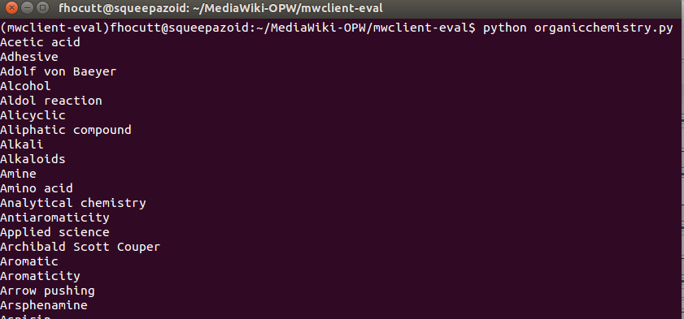
Using the mwclient module to query WP
import mwclient
wikipedia = mwclient.Site('en.wikipedia.org')
ochem = wikipedia.Pages['Organic chemistry']
links = ochem.links(generator=False)
for item in links:
print item

Slide 26
Potential API pitfalls
  Rate limiting
      Site limits the number of requests/hr allowed
  Authentication
      Send identity data with your request
      Some sites require it, some have higher rate limits for authenticated users
  Text encoding issues
      Show up with accented and non-English characters
      There is a difference between Unicode strings (u'string') and regular strings ('string')
      Try searching for [site] + encoding problem + api

Slide 27
Afternoon sessions
Building a dataset using the Wikipedia API
Building a dataset using Twitter
Wikipedia and Stack Exchange MySQL
CodeAcademy practice with APIs exercises

